Slide 1
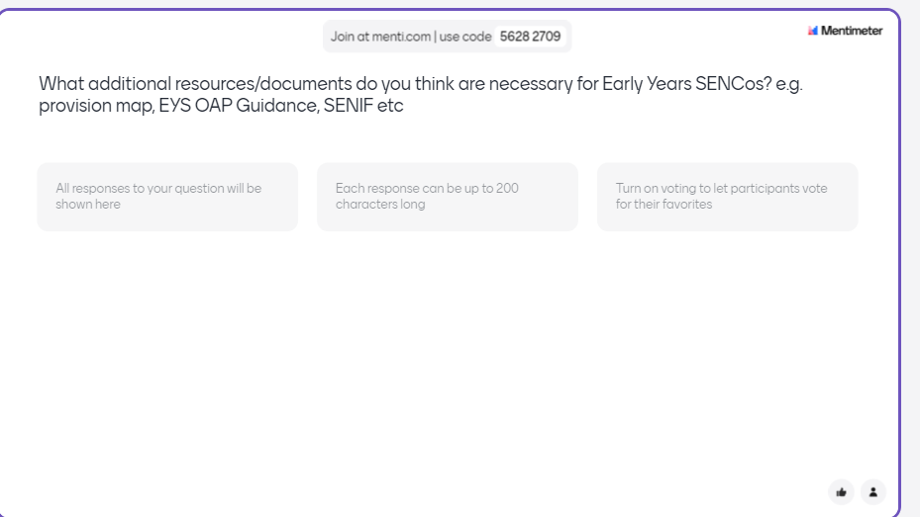
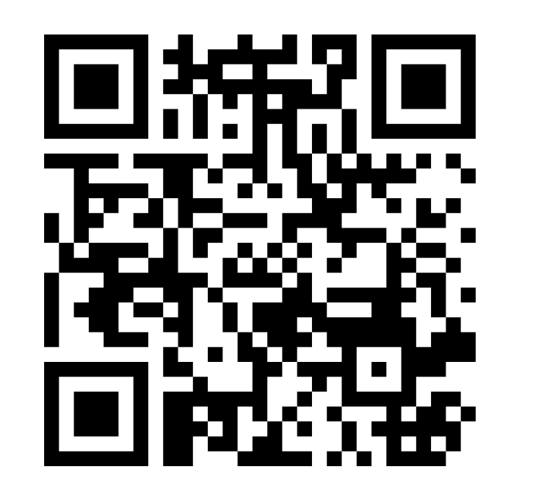
Obtaining your views now
https://www.menti.com/alz7zrwpjufz
Or via Menti.com and typing in the joining code below:
5628 2709
If you are interested in being part of the working group please email:
James.bateman@lbhf.gov.uk

