Slide 1

Early Years Entitlements & Synergy Portal Overview
Date: Thursday 16th January 2025
Time: 1pm – 2pm and 6pm – 7 pm

Slide 2
What we will cover
Overview of early years entitlements / eligibility criteria
Headcount dates
Funding rates for 2024/25 and proposed rates for 2025/26
Payment process
EYPP and DAF
SENIF
Navigating the Synergy Provider Portal
Checking eligibility codes
Adding/removing children
Submitting estimates/actuals
Term summary

Slide 3
9-23 Months Funded Childcare
Families with children aged 9 -23 months, who meet the eligibility criteria, are entitled to up to 15 hours per week of funded childcare for 38 weeks per year.
This starts from the term after child turns 9 months.
Child born: | Summer Term 1st April – 31st August | Autumn Term 1st September – 31st December | Spring Term 1st January – 31st March
Child eligible: | 1st September | 1st January | 1st April

Slide 4
Eligibility Criteria
Children aged 9-23 months will be eligible for up to 15 hours funded childcare if you live in England and family meets the following criteria –
Both parents (or one parent, if single parent family) need earn at least the equivalent of 16 hours at the national living wage or minimum wage per week
AND
Parent(s) earns less than £100,000 per year.

Slide 5
How to apply
The application process is managed by HMRC directly – all applications need to be made directly to them using weblink below -
Apply for free childcare if you're working - GOV.UK
Once a family applies, if eligible, they are given an 11-digit code to be given to their childcare provider (please note, parents will need to re-confirm their eligibility every 3 months)

Slide 6
2-Year-Old Funded Childcare
(families receiving additional support)
Families with children aged two years old, who meet the eligibility criteria, are entitled to up to 15 hours per week of funded childcare for 38 weeks per year.
This starts from the term after child’s second birthday.
Child born: | Summer Term 1st April – 31st August | Autumn Term 1st September – 31st December | Spring Term 1st January – 31st March
Child eligible: | 1st September | 1st January | 1st April

Slide 7
Eligibility Criteria
Two-year-olds can get funded childcare if you live in England and get one of the following benefit:
• Income Support
• Income-based Jobseeker’s Allowance (JSA)
• Income-related Employment and Support Allowance (ESA)
• Universal Credit, and your household income is £15,400 a year or less after tax, not including benefit payments
• tax credits, and your household income is £16,190 a year or less before tax
• the guaranteed element of Pension Credit
• the Working Tax Credit 4-week run on (the payment you get when you stop qualifying for Working Tax Credit)
Two-year-olds are also eligible for 15 hours of funded childcare if they meet one of the following:
• are looked after by a local authority
• have a statement of Special Education Needs (SEN) or an education, health and care (EHC) plan
• get Disability Living Allowance
• have left care under an adoption order, special guardianship order or a child arrangements order
If you’re a non-EEA citizen who cannot claim benefits.
If your immigration status says you have ‘no recourse to public funds’, you may still get funded childcare for your 2-year-old. You must live in England and your household income must be no more than:
£26,500 for families outside of London with one child
£34,500 for families within London with one child
£30,600 for families outside of London with two or more children
£38,600 for families within London with two or more children
You cannot have more than £16,000 in savings or investments.

Slide 8
How to apply
The application process is managed by LBHF – all applications need to be made directly to the local authority using the following weblink –
https://tri-borough.cloud.servelec-synergy.com/LBHF/FIS/Synergy/Parents/default.aspx
All applications will be processed within 3 weeks of applying - parent will then receive a letter via email with a 4- or 5-digit reference number confirming whether they are eligible.
N.B Applications can only be made once a child reaches 21 months of age.

Slide 9
DWP 2 YO List
H&F receive a list of families with 2-year-old children, from the Department for Working Pensions (DWP) that are potentially eligible to receive the 2-year-old, 15-hour entitlement for supported families.
We use this information to contact those families, informing them of the 2-year-old entitlement and encourage them to make an application.

Slide 10
2-Year-Old Funded Childcare
(working families)
Families with children aged two years old, who meet the eligibility criteria, are entitled to up to 15 hours per week of funded childcare for 38 weeks per year.
This starts from the term after child’s second birthday.
Child born: | Summer Term 1st April – 31st August | Autumn Term 1st September – 31st December | Spring Term 1st January – 31st March
Child eligible: | 1st September | 1st January | 1st April

Slide 11
Eligibility Criteria
Two-year-olds of working families will be eligible for up to 15 hours funded childcare if you live in England and family meets the following criteria –
Both parents (or one parent, if single parent family) need earn at least the equivalent of 16 hours at the national living wage or minimum wage per week.
AND
Parent(s) earns less than £100,000 per year.

Slide 12
How to apply
The application process is managed by HMRC directly – all applications need to be made directly to them using weblink below -
Apply for free childcare if you're working - GOV.UK
Once a family applies, if eligible, they are given an 11-digit code to be given to their childcare provider (please note, parents will need to re-confirm their eligibility every 3 months)

Slide 13
3- & 4-Year-Old Funded Childcare
(Universal Offer)
Families with children aged three and four years old are entitled to up to 15 hours per week of funded childcare for 38 weeks per year.
This starts from the term after child’s third birthday and continues right up until the term in which child turns 5 years old.
Child born: | Summer Term 1st April – 31st August | Autumn Term 1st September – 31st December | Spring Term 1st January – 31st March
Child eligible: | 1st September | 1st January | 1st April

Slide 14
How to apply
There is no application process for this funding stream as it is a universal offer.
All families with children aged 3 or 4 years old are entitled to this funding regardless of their circumstances.

Slide 15
3- & 4-Year Olds Funded Childcare
(Extended Entitlement)
Families with children aged three and four years old, who meet the eligibility criteria, are entitled to up to 30 hours per week of funded childcare for 38 weeks per year.
This starts from the term after child’s third birthday and continues right up until the term in which child turns 5 years old.
Child born: | Summer Term 1st April – 31st August | Autumn Term 1st September – 31st December | Spring Term 1st January – 31st March
Child eligible: | 1st September | 1st January | 1st April

Slide 16
Eligibility Criteria
Three- and four-year-olds will be eligible for up to 30 hours funded childcare if you live in England and family meets the following criteria –
Both parents (or one parent, if single parent family) need earn at least the equivalent of 16 hours at the national living wage or minimum wage per week.
AND
Parent(s) earns less than £100,000 per year.

Slide 17
How to apply
The 30-hour application process is managed by HMRC directly – all applications need to be made directly to them using weblink below -
https://www.gov.uk/30-hours-free-childcare
Once a family applies, if eligible, they are given an 11-digit code to be given to their childcare provider (please note, parents will need to re-confirm their eligibility every 3 months)

Slide 18
Reference numbers / Eligibility codes
Reference numbers
The term ‘reference number’ is used for 2-year-old for supported families only. Reference numbers are issued by LBHF and 4-5 digits long. Reference numbers do not need to be reconfirmed.
Eligibility codes
The term ‘eligibility code’ is used for working family entitlements only. Eligibility codes are issued by HMRC and 11 digits long. Eligibility codes need to be reconfirmed every 3 months.

Slide 19
Eligibility Codes
It is the parents' responsibility to reconfirm their eligibility code every 3 months. This is done via the parent’s childcare account with HMRC.
Start Date | End Date | Grace Period End Date
The date in which family has made an application to HMRC | The deadline in which family needs to reconfirm their eligibility | The date in which a family can continue to access the funding until, if the family fall out of eligibility

Slide 20
Disability Access Fund (DAF)
Disability Access Fund (DAF)
If you provide a funded place for any children who receive disability living allowance (DLA), your setting is eligible to claim disability access funding.
This is a one-off payment of £910 per child which is paid directly to the provider on an annual basis (one payment per financial year).
The payment can only be made to one provider and cannot be split so where a child is accessing their entitlement across more than one provider, the parent will need to decide which setting will receive the DAF payment.
Notes:
Moving on the Disability Access Fund which is also known as a DAF payment.
If you provide funded placements for any 3 or 4 year olds who receive disability living allowance (DLA), your setting is eligible to claim disability access funding.
This is a one-off payment of £828 per child which is paid directly to the provider on an annual basis (one payment per financial year).
The payment can only be made to one provider and cannot be split so where a child is accessing their entitlement across more than one provider, the parent will need to decide which setting will receive the DAF payment.

Slide 21
Early Years Pupil Premium (EYPP)
Early Years Pupil Premium (EYPP) is additional funding paid to early years providers to improve the education they provide to eligible children.
Childcare providers can claim an additional £0.68 pence per hour (£387 per year) to spend on enriching children in your settings education.
Notes:
Early Years Pupil Premium (EYPP) is additional funding given to early years providers to improve the education they provide to eligible 3 and 4-year-olds.
Childcare providers can claim an additional £0.62 pence per hour (£353 per year) to spend on enriching your 3 or 4 year old child’s education.
This funding can be used for things such as:
- buying equipment to support child’s learning and development, or
- employing specialist staff to help children develop their speech and language skills

Slide 22
Eligibility Criteria
To be entitled to Early Years Pupil Premium, the family will need to meet one of the following -
Income Support
income-based Jobseeker’s Allowance
income-related Employment and Support Allowance
support under part six of the Immigration and Asylum Act 1999
the guaranteed element of State Pension Credit
Child Tax Credit (provided you are not also entitled to Working Tax Credit) and have an annual gross income of no more than £16,190
Working Tax Credit run-on, which is paid for 4 weeks after you stop qualifying for Working Tax Credit
Universal Credit - your household income must be less than £7,400 a year after tax not including any benefits you get
adoption
special guardianship order
a child arrangements order
Notes:
The eligibility criteria for Early Years Pupil Premium is quite similar to that of the 2 year old funding so you could use this a pointer that if you have any children in your setting that were eligible for 2 year old funding, and they have now moved on to 3 & 4 year old funding, they may well be eligible for Early Years Pupil Premium (EYPP) also.
So to just name a few of the eligibility criteria points, 3 and 4 year olds may be entitled to Early Years Pupil Premium if family are in receipt of –
- Income Support
- income-based Jobseeker’s Allowance
- income-related Employment and Support Allowance
- support under part six of the Immigration and Asylum Act 1999
- special guardianship order
- a child arrangements order

Slide 23
Number of weeks per term
All funded entitlements are funded across 38 weeks per year (term time only)
This is the equivalent of 190 hours per term, 570 hours per year (or 380 hours per term, 1140 hours per year for 30-hour places)
The London Borough of Hammersmith and Fulham set their term weeks each term so the maximum number of weeks a provider can claim each term is 12.6666 weeks.
Stretched offer (all year round)
Some providers may choose to offer the funding as a stretched offer, whereby the child accesses less hours per week, over more weeks of the year.
Notes:
All funded entitlements are across 38 weeks per year (term time only)
The London Borough of Hammersmith and Fulham set their term weeks each term so the maximum number of weeks a provider can claim each term is 12.6666 weeks.
Stretched offer (all year round)
Some providers may choose to offer the funding as a stretched offer, whereby the child accesses less hours per week, over more weeks of the year.

Slide 24
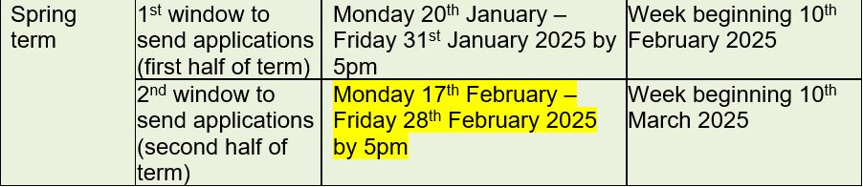

SEN Inclusion Fund (SENIF)
NOTE: This application window has been recently updated​
Access to all Early Years SENIF documents can be found here:
​
EY: SENIF documents - Learning Partnership​

Slide 25
Carry Forward Procedure
At the start of each term, children records are ‘carried forward’ from the previous term's headcount claim.
This process is used to avoid provider’s having to enter existing children's information each term. It is the providers responsibility to remove any children that have left their setting before the start of each term.

Slide 26
Child Weightings / Supplements
Early Years Pupil Premium (EYPP)
Provides an additional £0.68 per hour to all eligible children's funding rates
Deprivation
Provides up to an additional £1.33 per hour to a child’s funding rate for children from socially deprived backgrounds (based on child’s postcode).
Disability Access Fund (DAF)
One-off payment of £910 per eligible child. One payment per financial year.

Slide 27
Funding Rates for 2024/2025
9-23 months = £13.45 per hour
2-year-old (families receiving additional support) = £9.36 per hour
2-year-old (working families) = £9.36 per hour
3- and 4-year-old (universal offer) = £6.68 per hour
3- and 4-year-old (extended offer-30 hours) = £6.68 per hour
Disability Access Fund (DAF) = £910 per year
Early Years Pupil Premium (EYPP) = additional £0.68 per hour / £387 per year
Deprivation supplement = up to £1.33 per hour
Notes:
Funding rates for early years entitlements for 2022/2023 are as follows -
2 year old entitlement = £7.56 per hour
3 and 4 year old entitlement (universal offer) = £6.48 per hour
3 and 4 year old entitlement (extended offer) = £6.48 per hour
Disability Access Fund (DAF) = £828 per year
Early Years Pupil Premium (EYPP) = additional £0.62 per hour / £353 per year
SEN Inclusion Fund (SENIF) = up to £2,500 per term

Slide 28

DRAFT Early Years Funding Rates 2025/26
Payable from April 2025 (TBC February 2025)
 | 25/26 3 and 4 YO Entitlements (Universal & Extended | 25/26 2 YO Entitlements (Working Parents & Additional Support) | 25/26 Under 2 YO Entitlements (Working Parents
 | £ | £ | £
Base Rate - Participation based on estimated hours | 6.72 per hour | 10.05 per hour | 14.39 per hour
Average Deprivation Supplement - Participation based on estimated hours & paid on IDACI sliding scale on post codes – see next slide | £0.00 to £1.33 per hour based on postcode
Early Years Pupil Premium - additional funding for disadvantaged children was extended to all the Early Years offers from 2024/25. | £1.00 per hour up to £570 per year (Paid Termly)
Disability Access Fund - additional per pupil funding for those receiving Disability Living Allowance to access all EY entitlements. | £938 per year per eligible pupil (Paid as annual lump sum on application)
2025/26 Early Years Budget Briefing

Slide 29
Deprivation supplements all offers
IDACI Band | Proposed 2024/25 hourly rate
1 | 1.33
2 | 1.23
3 | 1.12
4 | 1.02
5 | 0.92
6 | 0.40
7 | 0.20
8 | 0.05
9 | 0.00
10 | 0.00
IDACI Banding Rates 2025/26 Across All Entitlements per funded Hour - Unchanged Versus 2024/25
https://imd-by-postcode.opendatacommunities.org/imd/2019
2025/26 Early Years Budget Briefing

Slide 30
How to claim EY entitlements
The following funding streams are claimed via the Synergy Provider Portal –
9-23 months funding for working families
2-year-old funding (families receiving government support and working families)
3- & 4-year-old funding – universal and extended entitlement
Disability Access Fund (DAF)
Early Years Pupil Premium (EYPP)
Link to Synergy Provider Portal - https://tri-borough.cloud.servelec-synergy.com/LBHF/FIS/Synergy/Login.aspx
Notes:
The following funding streams are claimed via the provider portal –
2 year old funding
3 & 4 year old funding – universal and extended entitlement
Disability Access Fund (DAF)
Early Years Pupil Premium (EYPP)
Link for provider portal - https://tri-borough.cloud.servelec-synergy.com/LBHF/FIS/Synergy/Login.aspx

Slide 31
Estimates vs Actuals
H&F make two EY payments per term - estimates and actuals
Estimates
This claim is not mandatory however providers may claim early years funding in advance.
This claim is made based on the estimated number of hours you will be offering for both universal and extended entitlements.
Actuals
This claim is made during the term and based on the number of eligible children taking up their entitlement at the setting.
This funding is paid at the end of term which is also known as balancing payment.

Slide 32
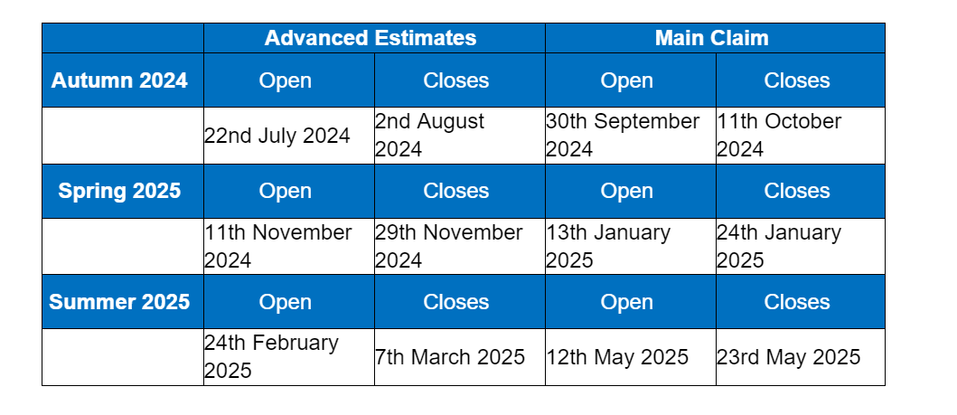
Headcount dates for 2024/2025
N.B – headcount dates for 2025/2026 will be communicated next term
Notes:
I have included the headcount dates for 2023/2024 which I thought would be helpful, but again, this presentation will be sent out to all of you so please don’t worry if your not able to write them all down.
Autumn
Estimate submission dates - 10th July 2023 – 21st July 2023
Headcount day - 5th October 2023
‘Actuals’ submission dates – 2nd October 2023 – 13th October 2023
Spring
Estimate submission dates - 13th November 2023 – 24th November 2023
Headcount day - 18th January 2024
‘Actuals’ submissions dates – 15th January 2024 – 26th January 2024
Summer
Estimate submission dates - 11th March 2024 – 22nd March 2024
Headcount day - 16th May 2024
‘Actuals’ submission dates - 13th May 2024 – 24th May 2024
Hammersmith and Fulham pays the termly estimate based on providers estimated hours for the term multiplied by the base rate, and the ‘actuals’ payment includes any supplements such as deprivation and EYPP ( Early Years Pupil Premium) where applicable.

Slide 33
How to register to offer funding
If any providers would like to register to offer any of the early years’ entitlements, please contact the Early Years Funding Officer via email.
Early Years Funding Officer – Renee.Daley@lbhf.gov.uk
Notes:
If any providers would like to register to offer any of the early years entitlements, it is very a simple process, so please contact me via email, and I will send you the application form and relevant documents.
– Renee.Daley@lbhf.gov.uk

Slide 34
Any Questions?
Feedback survey - https://forms.office.com/Pages/ResponsePage.aspx?id=FcHYUH-3lUOjujtAfK8NiIBUgHTUYHNNmdclTa-7yuZUQjlFWUE3SVBPMlBTWjJJQVhERzU5MUNOTy4u
Childcare costs survey – https://forms.office.com/pages/responsepage.aspx?id=FcHYUH-3lUOjujtAfK8NiH8uFUVccqxLhqqHJq4JdNBUNURFMDYzOTc0TVUwMjlLNkFBT00zMjBXTyQlQCN0PWcu&route=shorturl
Early Years Funding Officer - Renee.Daley@lbhf.gov.uk

