Slide 1
Covid boosters and flu jabs
For school staff
17.11.21
Dr N Lang, Director of Public Health

Slide 2
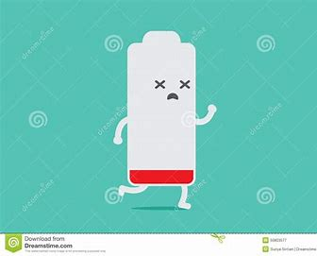
Who can have a Covid booster?
people aged 40 and over (from 22.11.21)
people who live and work in care homes
frontline health and social care workers
people aged 16 and over with a health condition that puts them at high risk of getting seriously ill from COVID-19
people aged 16 and over who are a main carer for someone at high risk from COVID-19
people aged 16 and over who live with someone who is more likely to get infections
Coronavirus (COVID-19) booster vaccine - NHS (www.nhs.uk)
Why do I need a booster?-your immunity gets low 5-6 months after the second dose

Slide 3
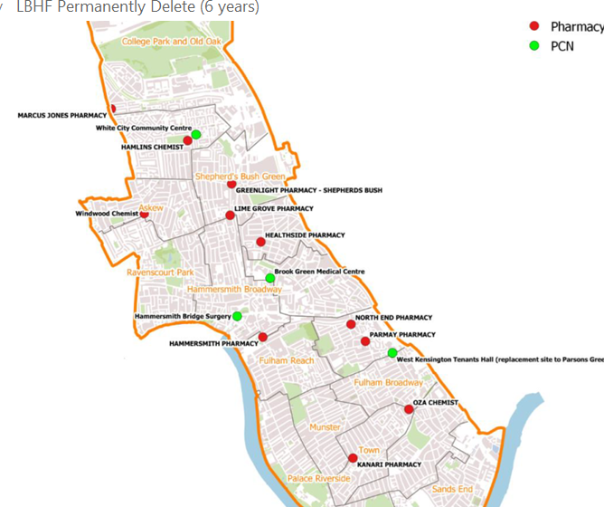
How do I get my Covid booster?
Walk in centre
GP practice
Pharmacy
Pop ups
Book online
Call 119
Walk-in some local pharmacies
Ring the H&F CAN team for help H&F CAN, call 0800 145 6095
Check the LBHF website for your nearest pharmacy
Covid-19 vaccine | LBHF

Slide 4
Showing I’m eligible for my Covid booster– walk in sites
You can get your booster dose at a walk-in COVID-19 vaccination site if you had your 2nd dose at least 6 months ago and you are:
aged 50 and over
aged 16 and over with a health condition that puts you at high risk from COVID-19 – you’ll need to bring your letter inviting you to get your booster dose or a letter from your doctor about your health condition
If you do not get a letter but you have a health condition and you think you’re eligible, contact your GP surgery.

Slide 5
Getting my flu jab
You can go to your GP or a local pharmacy, midwifery or hospital appointment
The flu vaccine is given free on the NHS to people who:
are 50 and over (including those who'll be 50 by 31 March 2022)
have certain health conditions
are pregnant
are in long-stay residential care
receive a carer's allowance, or are the main carer for an older or disabled person who may be at risk if you get sick
live with someone who is more likely to get infections (such as someone who has HIV, has had a transplant or is having certain treatments for cancer, lupus or rheumatoid arthritis)
frontline health or social care workers
Flu vaccine - NHS (www.nhs.uk)

