Slide 1
Famous Black Britons: Ignatius Sancho
(c. 1729 - 14 December 1780)
Notes:
All images in this resource are from The British Museum Collection Online database at www.britishmuseum.org/collection
Full object information for each image can be found at Collection Online using the Museum registration number for each object.

Slide 2
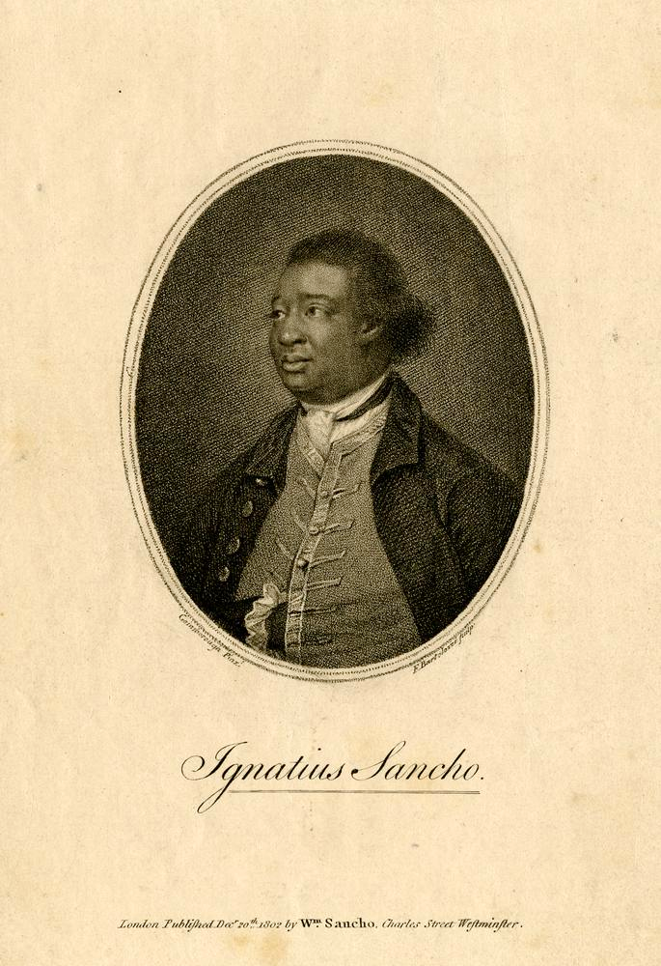
Notes:
Print portrait of Ignatius Sancho, 1802
Half-length portrait of Ignatius Sancho in an oval frame. Used as the frontispiece to 'Letters of the late Ignatius Sancho' which was published in London in 1802 by William Sancho, Charles Street, Westmisnter. This print is based on a painting by Thomas Gainsborough.
British Museum 1871,1209.5621

Slide 3
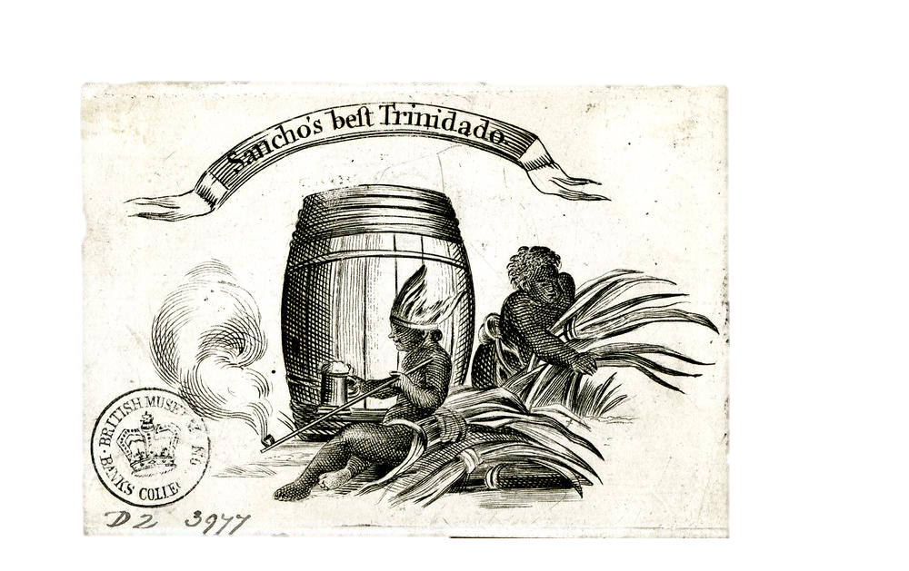
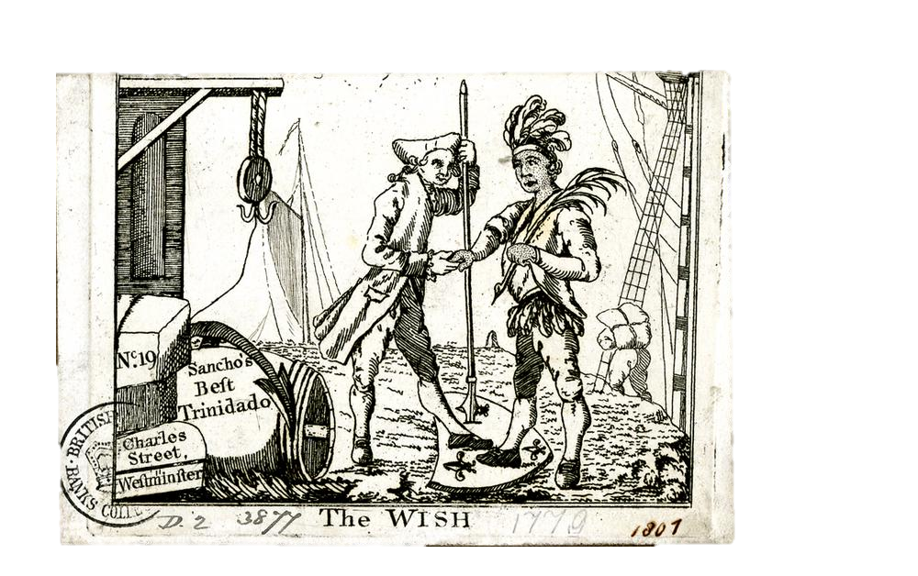
Notes:
Top: Tobacco-paper, c. 1774-1780
Wrapper for (Ignatius) Sancho's Best Trinidado with showing two boys beside a barrel in the centre, a native American, with feather headdress holding a tankard and long pipe, sitting on the ground on the left and an enslaved African gathering sheaves of tobacco leaves.
British Museum D,2.3977
Bottom: Trade card, before 1807
'The wish', tobacco-paper for (Ignatius) Sancho's Best Trinidado, at No. 19 Charles Street, Westminster. Shows a European trader shaking hands with a native American, both with a foot on a shield with the fleur-de-lis of France. To left boxes, a barrel and anchor beneath a pulley and to the right ships' sails and masts. To the lower right the date 1807 has been written in ink; probably the date when the collector Sarah Sophia Banks acquired the card.
British Museum D,2.3877

Slide 4
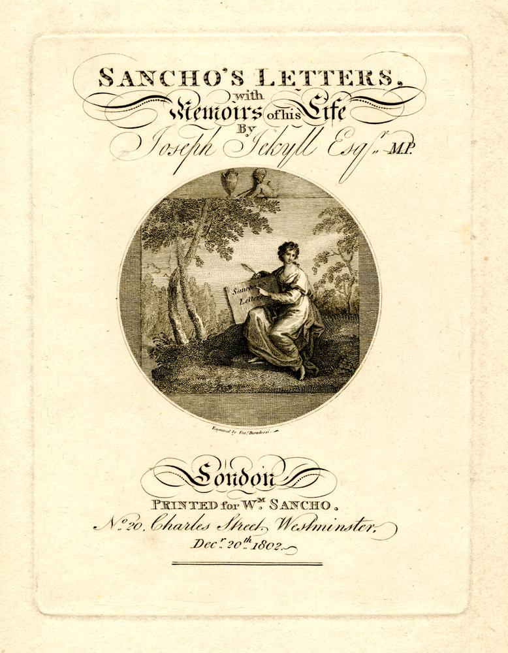
Notes:
Title page, 1802
Title page of the book Sancho's letters with memoirs of his life by Joseph Jekyll first published in 1783. This 1802 edition was printed by William Sancho, Charles Street, Westminster.
British Museum 1868,0808.2842

Slide 5
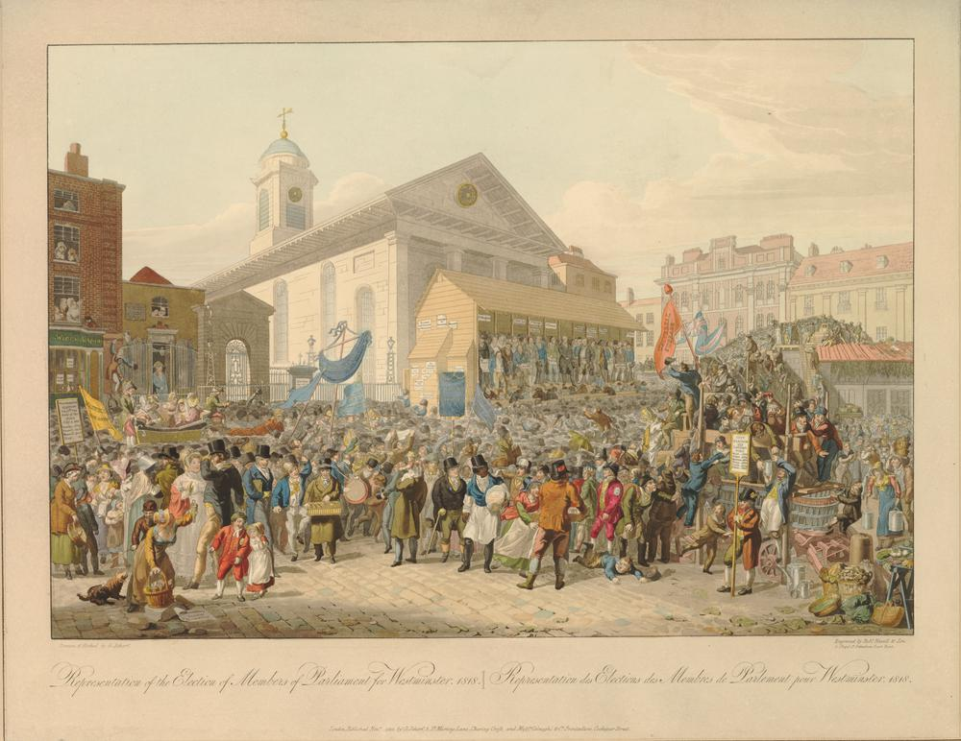
Notes:
Election of Members of Parliament for Westminster, 1818
A large crowd gather in Covent Garden by a covered platform erected in front of St. Paul's Church from where the candidates make their speeches. The market is full of groups of people, supporters carrying banners marked with political slogans and boards being held up to show the previous day’s poll results.
British Museum 1880,1113.3088

Slide 6
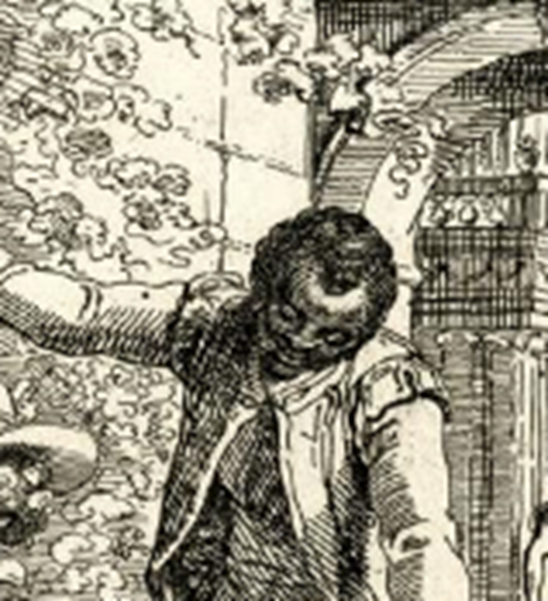
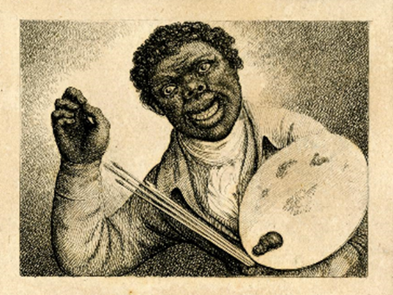
Notes:
Ottobah Cugoano
Left: Detail from a print of Ottobah Cugoano in a garden with the artists Richard and Maria Cosway.
British Museum 1863,0110.86
Right: Print of Ottobah Cugoano holding an art palette and a brushes.
British Museum 1852,0214.115

Slide 7
The British Museum
Notes:
All images from British Museum Collection Online
www.britishmuseum.org/collection
© The Trustees of the British Museum

