Slide 1
Famous Black Britons: Nanny of the Maroons
(c. 1686 - c.1750)
Notes:
All images in this resource are from The British Museum Collection Online database at www.britishmuseum.org/collection
Full object information for each image can be found at Collection Online using the Museum registration number for each object.

Slide 2
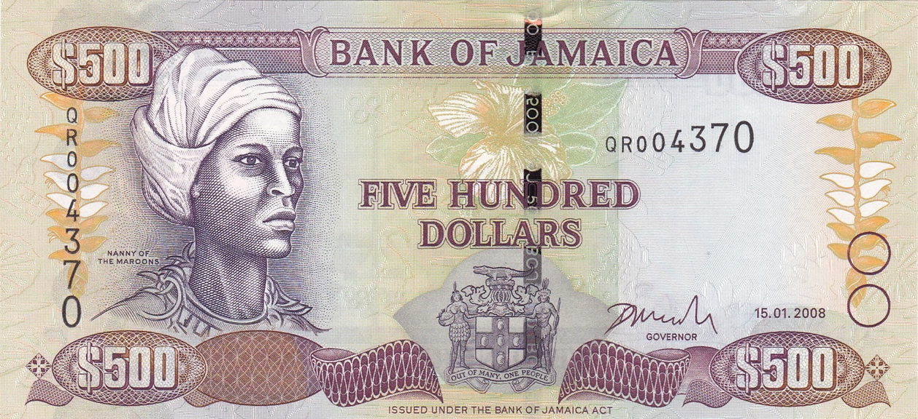
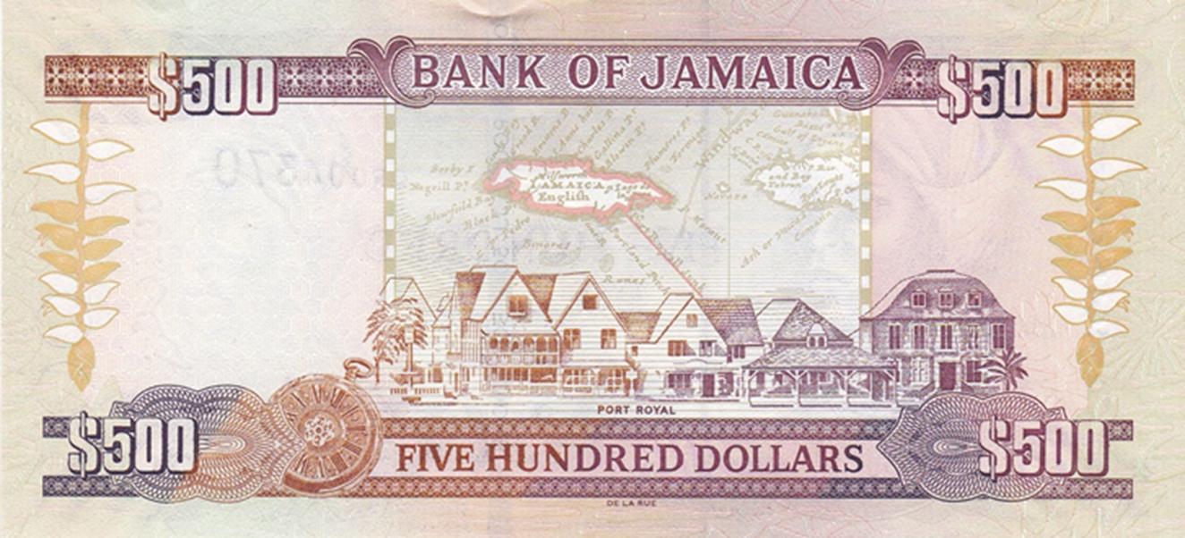
Notes:
Banknote, 2003
The front of the banknote shows militia leader Nanny of The Maroons at left. On the back is an historical map of the islands above buildings in Port Royal. The design printed in purple, orange, brown and green.
Printed in 2003 for the Bank of Jamacia which is Jamaica's central bank and monetary authority established in 1960.
British Museum 2005,0830.58

Slide 3
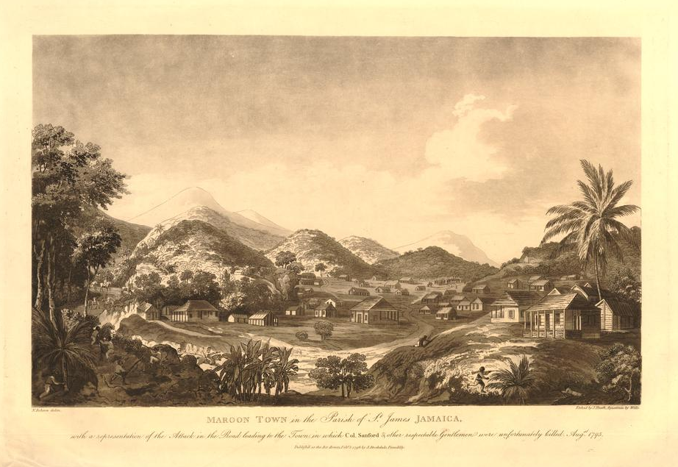
Notes:
Print of a Maroon town, 1796
This print shows a Maroon Town in the Parish of St James Jamaica. The town contains wooden buildings with shaded porches, with low hills covered in trees behind them, a palm tree to the right, men among the rocks and bushes on a hill-top in the foreground, some cavalry approaching from the left as part of an armed encounter which took place in August 1795. Print made in 1796.
British Museum 1881,1210.256

Slide 4
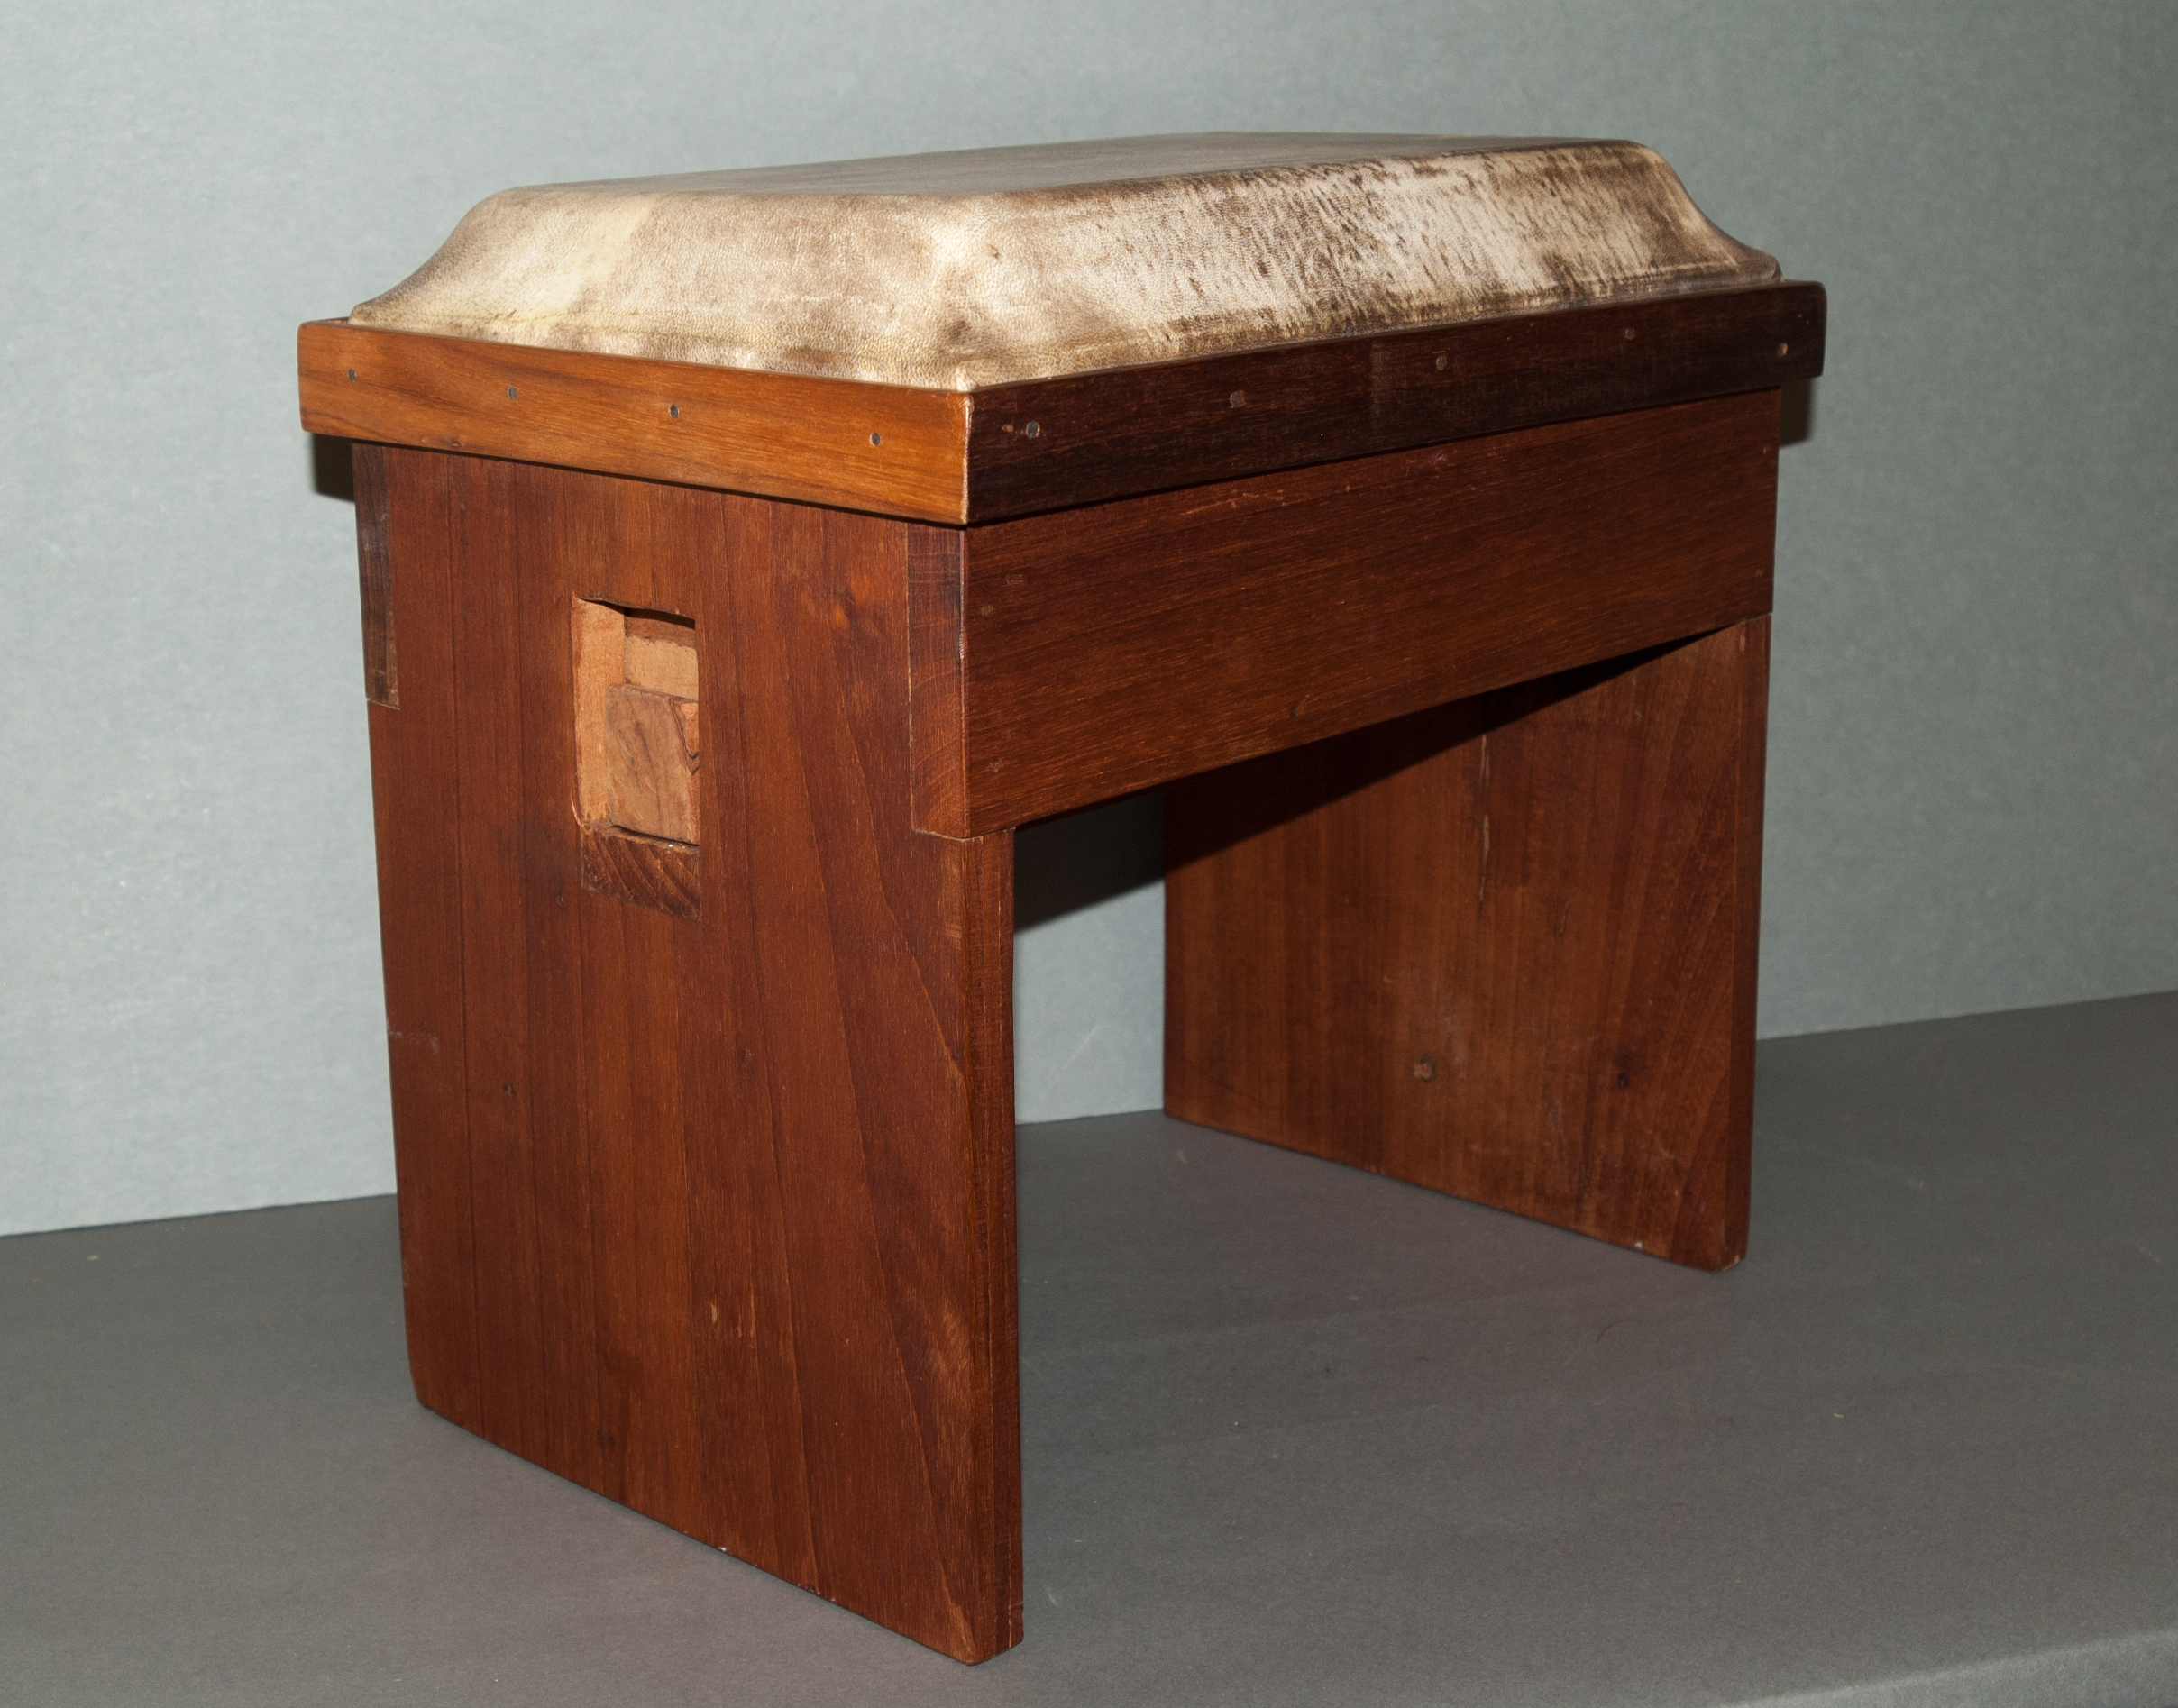
Notes:
Bench drum, 2010-12
A bench drum, also called a Karamante drum with a rectangular base carved from hard wood and covered with goat skin. It has two hardwood planks as bench legs are secured with wood stantion through the middle of side planks. Signed underside of drum ‘Barlow White’ with phone number. The Karamante drum is still used today in Jamaica by Maroons. It was illegal for enslaved people in Jamaica to make, own or play drums during the 1700s. This led to the creation of the bench drum, a musical instrument that looked like a seat but was in fact a drum. According to the Charles Town Maroon Council, Karamante drums are used to heal, communicate and for recreation. In 2014, this drum's maker, Barlow White made a bench drum and was awarded the UNESCO Award of Excellence for Handicraft.
British Museum 2012,2043.1

Slide 5
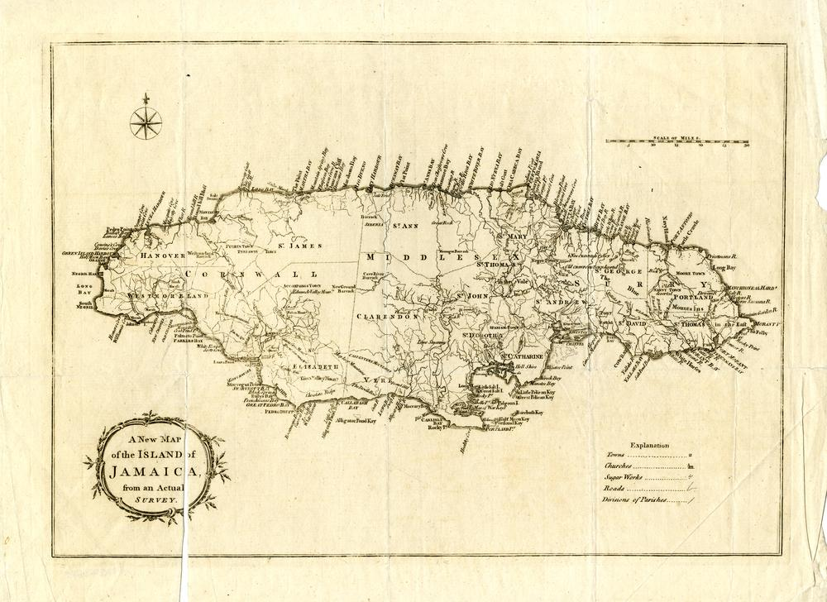
Notes:
Map, 1770-1850
Map of Jamaica showing towns, churches, sugar works, roads and division of Parishes created around 1770-1850. Title in a frame reads ‘A New Map of the Island of Jamaica from an Actual Survey.’
British Museum 1868,0822.5015

Slide 6
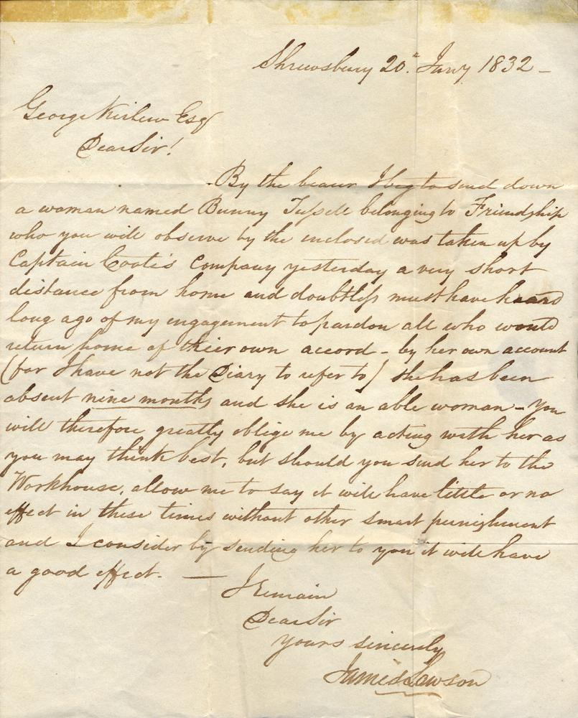
Notes:
Letter, 1832
Letter dated 20 January 1832 written from Shrewsbury [Estate], Westmoreland Parish, Jamaica from James Lawson an attorney managing the estate on behalf of the owner George Pitt-Rivers. In 1832 there were 322 enslaved people working on the Shrewsbury Estate and the associated Mount Carmel estate. The letter is addressed to George Kirlew who lived from around 1815 to 1839 at Phoenix Park, a 40 acre country house estate about a mile north of Savanna-la-Mar in Westmoreland Parish, Jamaica. George was another Jamaican based Planting Attorney who administering several estates for overseas owners. The letter discusses a runaway enslaved woman named Bunny Tussele. Bunny is a nickname derived from names such as Barbara and Bernice and can be used as a first name. The letter explains that Bunny ‘belongs’ to Friendship [and Greenwich Estate?]. Bunny has been absent from her enslaved plantation work for nine months and has recently been captured by British soldiers. The letter notes that ‘by her own account (for I have not the diary to refer to) she had been absent nine months [underlined] and she is an able woman.’
British Museum Am,EPH-AOA,B2.3

Slide 7
The British Museum
Notes:
All images from British Museum Collection Online
www.britishmuseum.org/collection
© The Trustees of the British Museum

