Slide 1
EHC Casework Service update – October 2023
We have recently completed a recruitment campaign to increase the number of EHC Coordinators to support the delivery of quality and timely casework.
There have been a number of staff changes over the summer period – this has included increasing the capacity of EHC Team Managers as well as new agency and permanent EHC Coordinators. We apologise if you have experienced some challenges with communication during this period of change for the service.
EHC Coordinators will be working in Hammersmith & Fulham for a minimum of 2 days a week. This has been designed to encourage in-person activity with parents/carers, educational settings and other professionals. We want EHC Coordinators to be connected to the community and residents they serve.

Slide 2
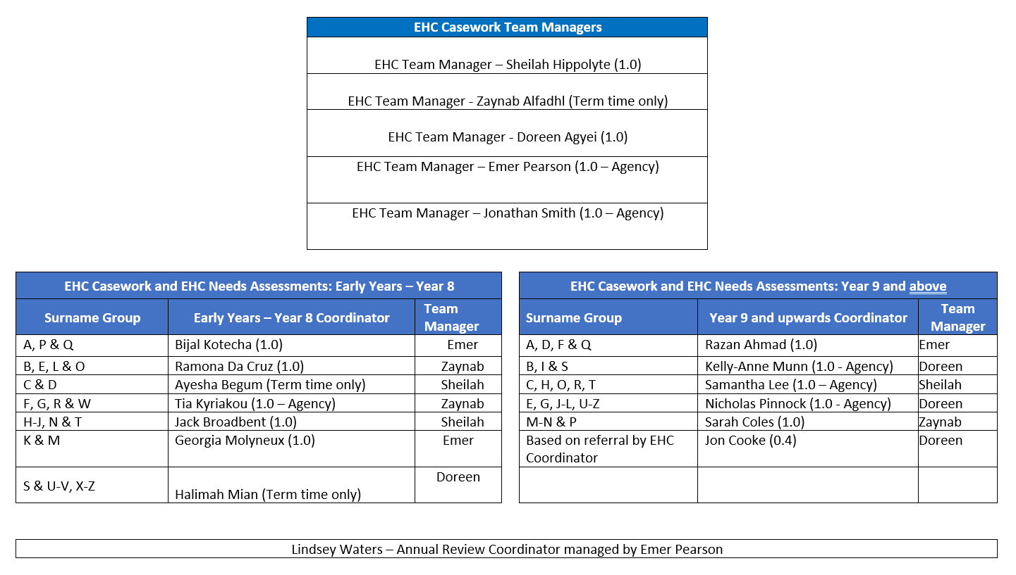

Slide 3
EHC Plans - Phase Transfer process
Nursery to primary/primary to secondary
Individual EHC Coordinators have sent parental preference forms to those parents/carers who have children approaching a transition in September 2024 (Year -1 and Year 6). These were sent on the 22nd September 2023.
Preference forms are due back on the 13th October 2023. Please remind parent/carers to submit their forms as soon as possible.
The LA will amend and name a new school placement in the EHC Plan’s of those children concerned by 15th February 2024.

Slide 4
EHC Plans - Phase Transfer process
Secondary to post-16
Individual EHC Coordinators will send young person/parental preference forms by X
Young person/parental preference forms are due back on the X Please remind young people/parent/carers to submit their forms as soon as possible.
The LA will amend and name a new education placement in the EHC Plan’s of those young people concerned by 31st March 2024.

Slide 5
Phase Transfers – Things to be aware of
We will begin to send consultations to schools from 16th October onwards. We are conscious that this falls over half term and so will begin the 15 day consultation period after half term.
SENCO’s may receive consultations outside of the phase transfer timeline for children who are undergoing an EHC Assessment and you should respond accordingly. The LA is unable to dictate or control when EHC applications are received by education settings/parents although we can advise that these should ordinarily come outside of transition years.

Slide 6
Phase Transfers – Things to be aware of
For any cases where you have concerns around the admission of a child/young person we would strongly recommend an individual conversation/meeting with the EHC Coordinator/EHC Team Manager concerned to see how the LA can support with resolution.
We will issue Final Amended EHC Plans between 15th January 2024 -15th February 2024 for early years/primary and primary/secondary.
We will issue Final Amended EHC Plans between 15th February 2024 – 15th March 2024 for secondary to post-16.

Slide 7
Communication with the EHC Service
Keep talking to us. Whilst EHC Coordinators do manage a busy caseload (130-160 children/young people with EHC plans or under EHC assessment) I expect the service to be responsive and to work closely with you.
Please do let me know when communication with the EHC service is good and also where it is not so good and requires improving.
I am happy to organise a time to come and visit your setting individually to discuss your EHC cohort – please do reach out to me if this would be of benefit.
EHC Staff can reached using the format forename.surname@lbhf.gov.uk

Slide 8
Improving the quality of EHCPs:
Refreshing the Annual Review Guidance
SENCO Forum
July 2023
Jack O’Donoghue

Slide 9
What are we aiming to achieve?
Key driver is to improve the quality of EHCPs
New national focus with mandatory collection of Annual Review timeliness in the next SEN2 return and data published annually.
Support schools to fulfil their role in the statutory Annual Review process so that reviews are high-quality and timely.
Improve the quality of the experience for CYP and their families.
Ensure the local authority is able to meet its statutory responsibilities to make important decisions regarding the EHCP (maintain, amend, cease).

Slide 10
Improving the quality and timeliness of Annual Reviews – what are we doing?
Recruited an Annual Review Coordinator to coordinate the Annual Review Process with schools including improving the notification process of forthcoming reviews.
Rebalanced the Annual Review caseload across new resource
Refreshed the Annual Review Guidance and toolkit
What are we planning?
Introduction of individual feedback forms for the child/young person and their families following the finalisation of each EHCP and Annual review to understand their experience of the process including how they are involved in decision-making.
Longer term - Development of an SEN Portal to initiate the Annual Review Process

Slide 11
Additional Tools to upload to Local Offer
Guidance on writing SMART outcomes including examples
Pre-review questionnaire for families
Tools to support young people in expressing their views

Slide 12
Next Steps
Launch and request feedback at SENCO Forum in the Spring Term
Add to resources on local Offer including shared good practice through the SENCO Forum

