Slide 1
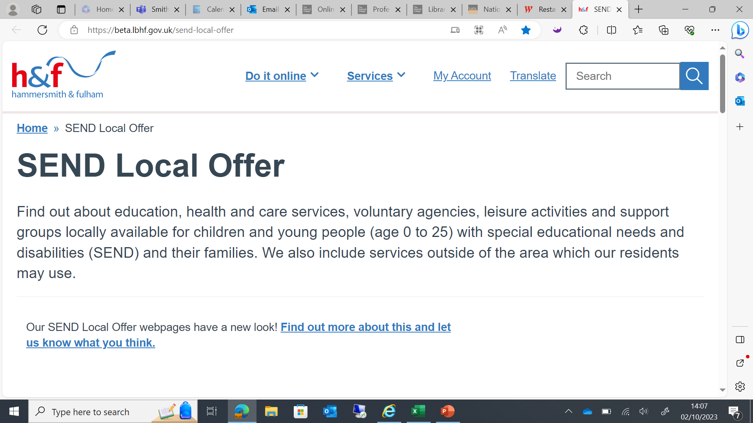
Welcome to Network SENCo Forum Meeting

Slide 2
Agenda
1. Welcome and introductions
2. JCT update
3. EHCNA documentation – Break out room activity
4. Annual Review Guidance - Break out room activity
5. H&F Notices
6. Network SENCO Forum Meeting Dates 2023/2024 7. A.O.B

Slide 3
Welcome and Introductions

Slide 4
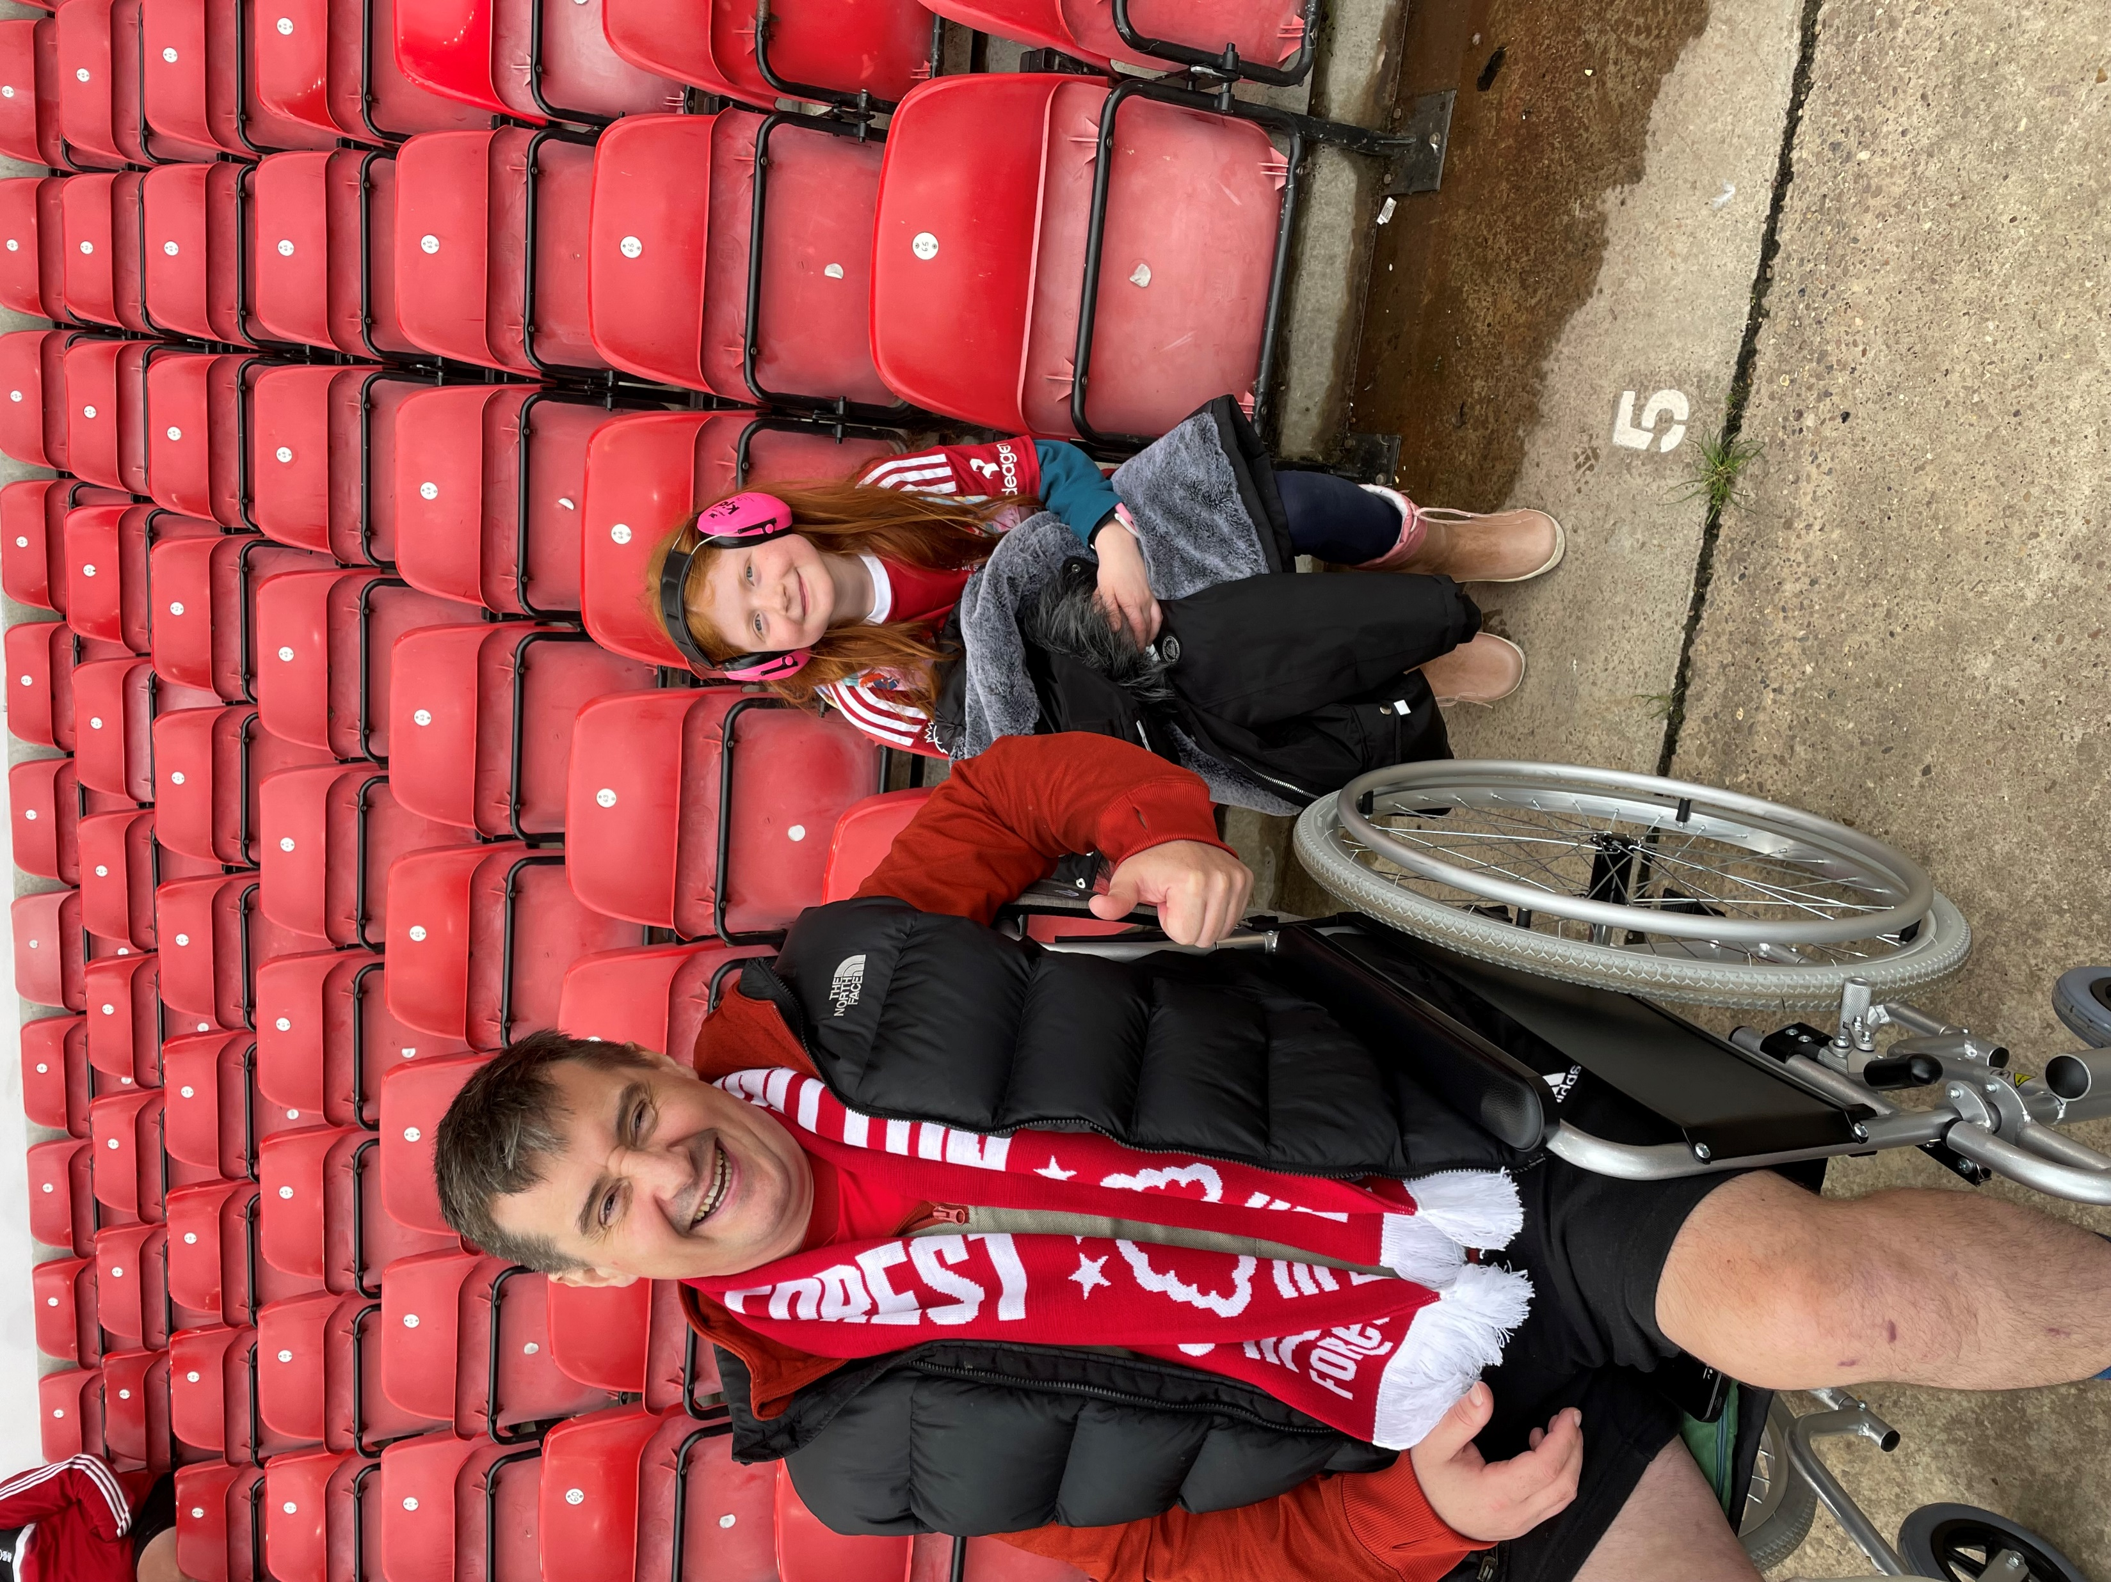
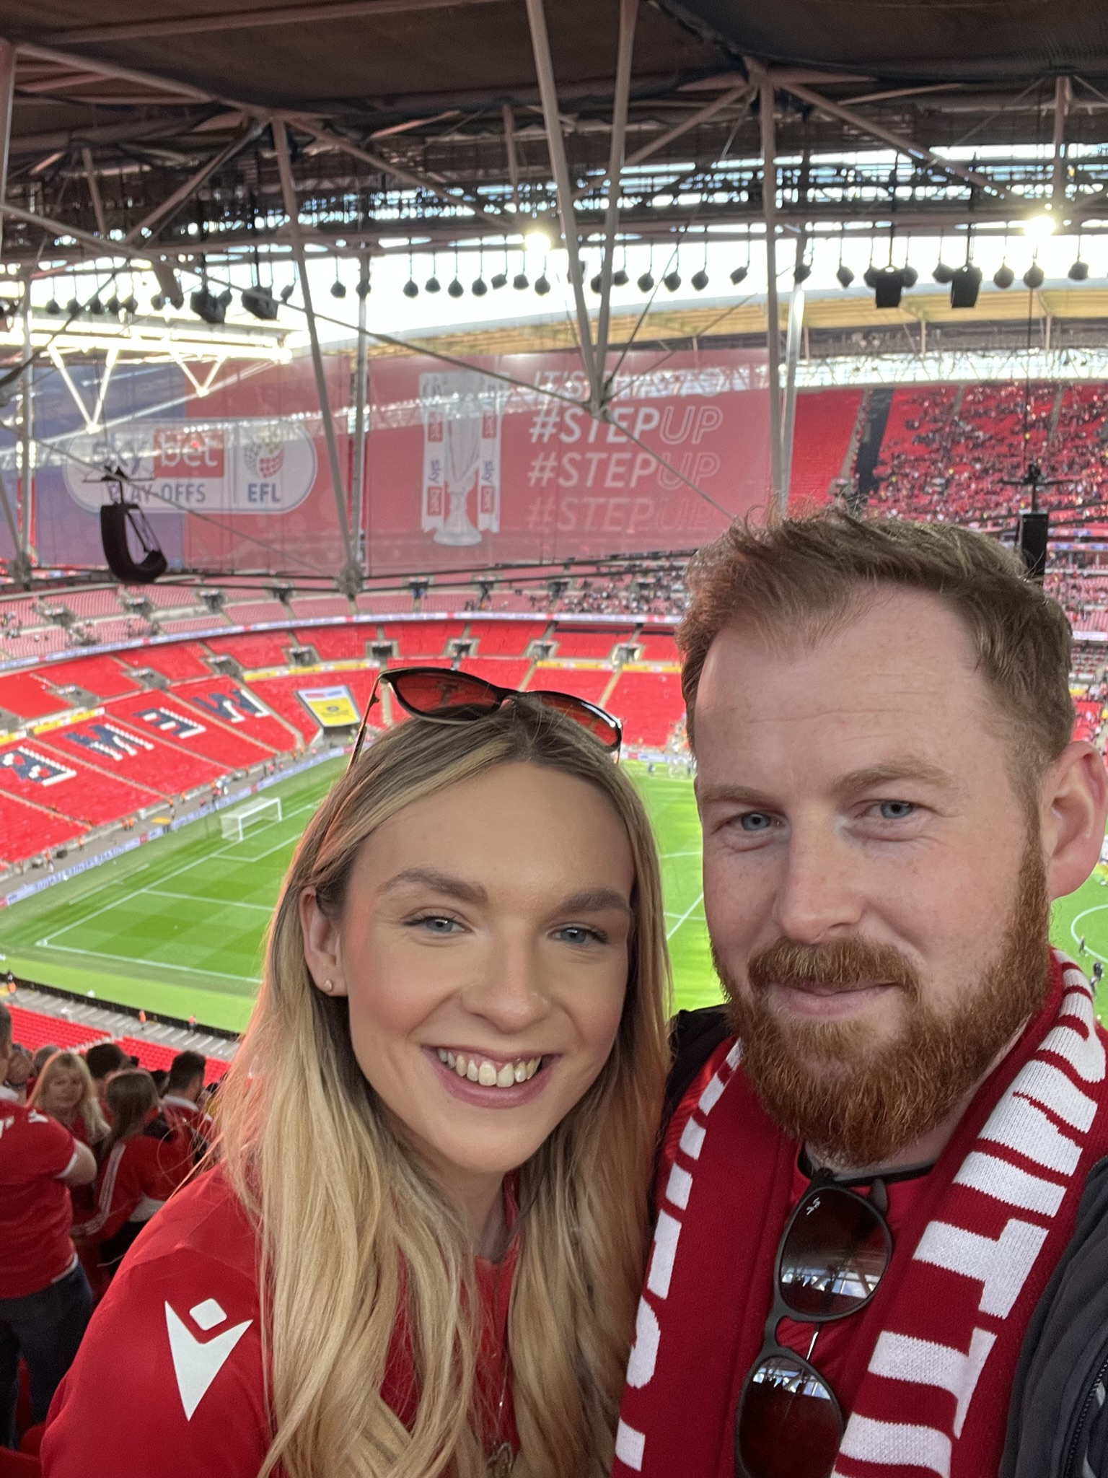
Whistle Stop Tour- A bit about me My interests
My Background:-
Secondary School PE Teacher
Head of Year 9&11 at the same time whilst teaching PE
SENCo
Assistant Head and SENCo
Trust Lead SENCo and Assistant Head
SEND Adviser
Now here
My Passion:-

Slide 5
Overview of Area SENCo role
Meet with CYP and Parent Forums
Meet with EP’s/OT/SALT/Social Care/Inspire/School Improvement workforce
Sit on the EHCP Panel meetings
Visits to settings:- Individualised Approaches (EYFS-Post 16/APs/Mainstream/Primary-Secondary)
Carry out Reviews of SEND Information/ SEND Policies
Develop and Support all SENCos but ensuring that the new to role/new to borough SENCos are well inducted.
Facilitate Network SENCo Forum Groups (Whole and Secondary)
Translate the ‘OA’ into INSET modules for SENCO’s to share with their schools – Train the trainer model.
Work with UCL on New SENCo Framework 2024/25

Slide 6
My role as Area SENCo in a Nutshell. Provide professional leadership and guidance to ALL SENCos across the borough and ensure that SEND policy and initiatives are being implemented effectively. Be the link between H&F and all settings on SEND Related matters whilst supporting CYP and families with SEND and Neurodivergent conditions.
And I can’t wait to see you all face to face

Slide 7
JCT update Alison Leao

Slide 8
Annual Review Guidance
Jack O’Donoghue

Slide 9
Improving the quality of EHCPs:
Refreshing the Annual Review Guidance
SENCO Forum
October 2023
Jack O’Donoghue

Slide 10
What are we aiming to achieve?
Key driver is to improve the quality of EHCPs
New national focus with mandatory collection of Annual Review timeliness in the next SEN2 return and data published annually.
Support schools to fulfil their role in the statutory Annual Review process so that reviews are high-quality and timely.
Improve the quality of the experience for CYP and their families.
Ensure the local authority is able to meet its statutory responsibilities to make important decisions regarding the EHCP (maintain, amend, cease).

Slide 11
Improving the quality and timeliness of Annual Reviews – what are we doing?
Recruited an Annual Review Coordinator to coordinate the Annual Review Process with schools including improving the notification process of forthcoming reviews.
Rebalanced the Annual Review caseload across new resource
Refreshed the Annual Review Guidance and toolkit
What are we planning?
Introduction of individual feedback forms for the child/young person and their families following the finalisation of each EHCP and Annual review to understand their experience of the process including how they are involved in decision-making.
Longer term - Development of an SEN Portal to initiate the Annual Review Process

Slide 12
Additional Tools to upload to Local Offer
Guidance on writing SMART outcomes including examples
Pre-review questionnaire for families
Tools to support young people in expressing their views

Slide 13
Next Steps
Launch and request feedback at SENCO Forum in the Spring Term
Add to resources on local Offer including shared good practice through the SENCO Forum

Slide 14
EHCNA documentation
Jack O’Donoghue/ Elaine Peers

Slide 15
H&F notices
CYP Forum
H&F Local Offer
H&F Ordinarily Available Provision
H&F School Improvement- EBSA Survey
H&F SEN OT Online Survey
InSpire Coffee Mornings 2023-24
Parents Active
Employment Pathways
Learning Partnership Website- Training Offers
EHCP Panel Meetings
ADHD Resources
TES SEND Show
Inclusive Events Calendar
Network SENCo Forum Meeting Dates 23/24

Slide 16
Strengthening Youth Voice and Embedding Co-production- SENCO FORUM
YOUTH VOICE COORDINATOR BRENDA WHINNETT

Slide 17
Purpose of Youth Voice
Young people’s experiences continually improving practice
Valuing the voices our young residents to shape a happier, healthier and safer borough.
Expanding opportunities and possibilities in young people’s lives
Young people as influencers, co-producers, & agents
of change
Doing things with residents, not to them
Driving policy strategy & commissioning decisions
Young residents feel valued, connected to the community & gain transferable skills

Slide 18
Our Areas of Focus
YOUTH VOICE Research: Aims
Inclusion
Inclusive, fun and creative methods of engaging with young people!
To truly understand young people’s lived experiences and what they want and need in relation to our areas of focus.
Streamline youth voice activity and strengthen the impact:
‘Bottom-up’ approach
Ensure meaningful involvement
Identify opportunities for real influence
Young people’s findings inform and shape the direction of travel and feed into strategic planning at all levels.
Staying safe
Life Skills
Mental Health & Emotional Well-Being
Work Readiness & Work Experience

Slide 19
Youth Voice & SENCO FORUM
Capturing the lived experiences of young people with SEND (e.g. ADHS, Autism, Dyslexia) to inform practice and policy in schools.
Video from and live discussions with young people at SENCO Forum.
Young people to co-produce resources & recommendations
SENCO’s to champion the young people’s recommendations and support other young people to contribute

Slide 20
H&F Local Offer
SEND Local Offer | London Borough of Hammersmith & Fulham (lbhf.gov.uk)

Slide 21
H&F Ordinarily Available Provision
H&F Ordinarily Available Provision – Information for professionals, parents and carers (lbhf.gov.uk)

Slide 22
H&F School Improvement- EBSA Survey
FINAL DEADLINE of FRIDAY 6th October 2023.
Thank you to those who have already completed and returned to Ann.Kenny@lbhf.gov.uk

Slide 23
H&F SEN OT Online Survey
Here is the link:
https://forms.office.com/e/KMLb5Mkqm5
Deadline 6th October 2023

Slide 24
InSpire Coffee Mornings 2023-24

Slide 25
Parents Active- Parentsactive – Realising our children's rights

Slide 26
Employment Pathways
For more information contact Helen Green
helen.green@lbhf.gov.uk

Slide 27
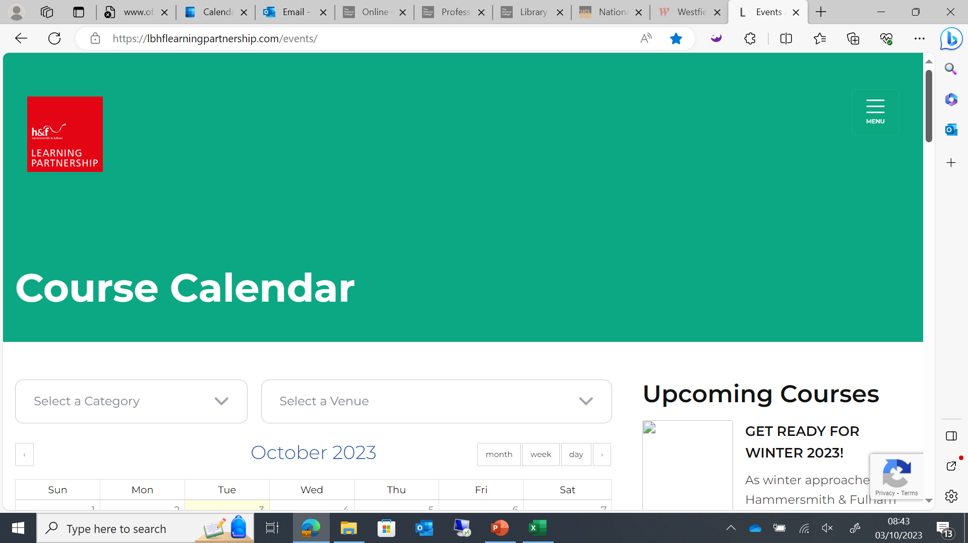
Learning Partnership Website- Training Offers
Events Archive - Learning Partnership (lbhflearningpartnership.com)
Lots of very useful CPD courses that are FREE!

Slide 28
EHCP Panel Meetings
Great CPD Opportunity!!!
The EHCP Panel meetings are every Thursday 9:30am-12:30pm
If you would like to be involved in these meetings in the capacity of an observer, then email:-
SEND Panels and Sandra Peyton
sendpanels@lbhf.gov.uk and sandra.peyton2@lbhf.gov.uk

Slide 29
Schools 2023 to 2024 census dates
Autumn census
• census date – Thursday 5 October 2023
• return date – Wednesday 1 November 2023
Spring census
• census date – Thursday 18 January 2024
• return date – Wednesday 14 February 2024
Summer census
• census date – Thursday 16 May 2024
• return date – Wednesday 12 June 2024
The School Census – what you need to know - The Education Hub (blog.gov.uk)
Complete the school census - Generate and submit your return - Guidance - GOV.UK (www.gov.uk)
Complete the school census - Which schools and pupils to include - Guidance - GOV.UK (www.gov.uk)
Complete the school census - Check your data - Guidance - GOV.UK (www.gov.uk)

Slide 30
October- ADHD Awareness Month- Signpost to resources
Resources Archive - ADHD Foundation : ADHD Foundation

Slide 31
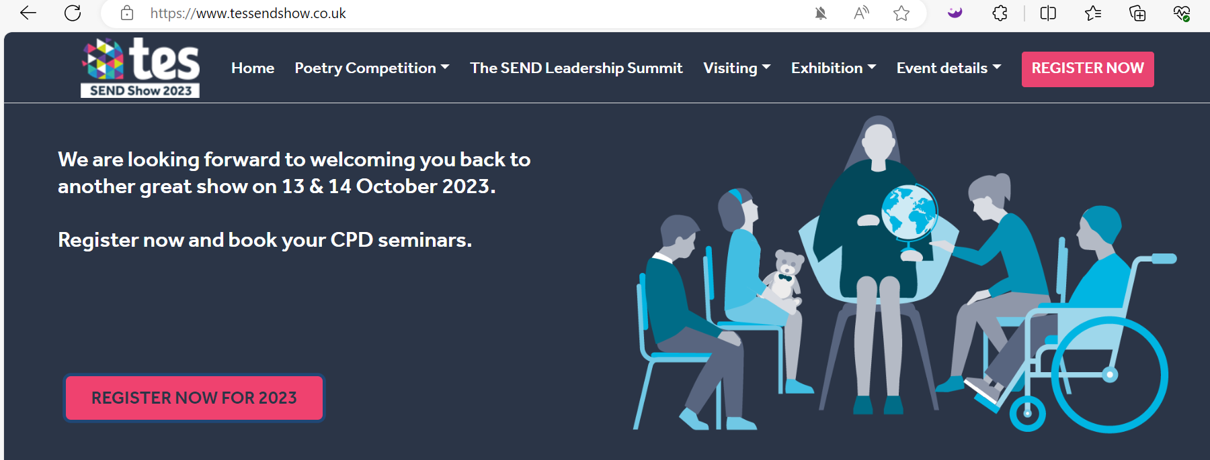
TES SEND Show on 13-14th October
Tes SEND 2023 Registration

Slide 32
Inclusive Events Calendar
Disability and accessibility-related events calendar | AbilityNet
To raise awareness and demonstrate inclusive culture- the below website helps to put items on people’s radar.

Slide 33
Network SENCO Forum Meeting Dates 2023/2024- ALL Face to Face
If your setting are prepared to host, please either scan the QR code or click the link to register your interest.
Friday 17th November @ 3 Shortlands 2pm-4pm
Wednesday 7th February-Time and Venue TBC
Tuesday 12th March- Time and Venue TBC
Wednesday 22nd May- Time and Venue TBC
Tuesday 2nd July- Time and Venue TBC
https://forms.office.com/Pages/ResponsePage.aspx?id=FcHYUH-3lUOjujtAfK8NiOFivPgAMFBDmi1Vtlt5L6tURUZFSVNTRU9XUk9GWVRCTEpTQ1RWRllBQS4u

Slide 34
Thank you for attending and your attention

