Slide 1
UKHSA London Region: We’re making changes on 16 April 2024 New North London Health Protection team and new contact details
What’s changing and when?​
On 16 April our two north London teams (NWL and NENCL) are joining to become one North London health protection team, to work alongside our South London health protection team and delivering the same high-quality service.
At the same time, we’re changing email addresses, so both our North London (NL) and South London (SL) teams will use the same new email addresses:
london.region@ukhsa.gov.uk
phe.london.region@nhs.net for PII (patient identifiable information)
Our phone number will stay the same 0300 30 30 450. Please use this number, during the day or out of hours, and regardless of where in London you are calling from.
Our new contact details are listed on the next page.
Our updated contact details will be updated on gov.uk: Contacts: UKHSA health protection teams - GOV.UK (www.gov.uk)​
What do you need to do ?​
Please use our new email addresses from 16 April, regardless of where you are contacting us from.
Please continue using our phone number 0300 30 30 450 ​
Please update any material which includes our contact details e.g., websites, guidance ​
Please share these changes with your colleagues
Thanks very much, as always if you have any questions please contact us.
UKHSA London Region

Slide 2
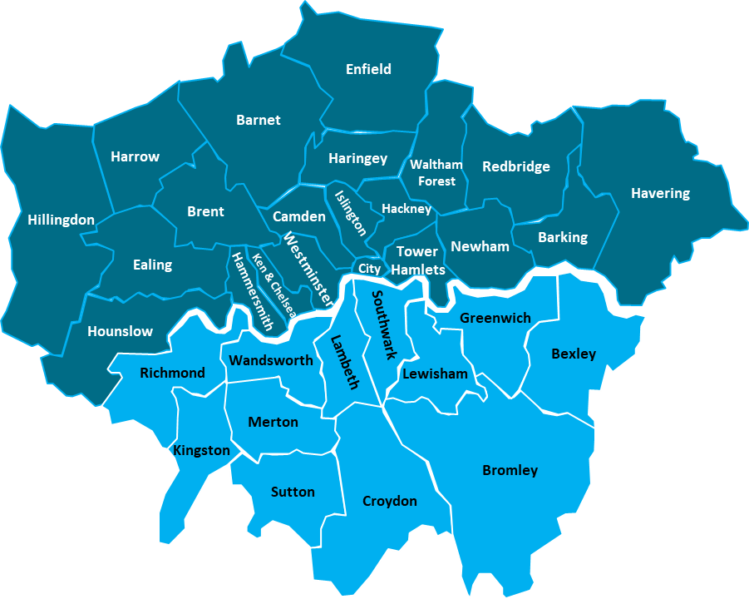
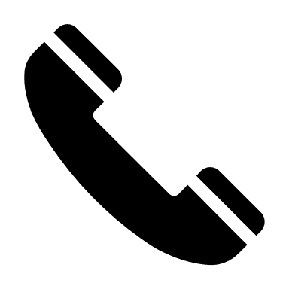
UKHSA London Region Contact Details from 16 April 2024
North London Health Protection Team
0300 30 30 450
london.region@ukhsa.gov.uk
phe.london.region@nhs.net for PII (patient identifiable information)
South London Health Protection Team

